Slide 1
DIGITAL ANALYTICS
Notes:
Image by freepik.com

Slide 2

Introduction
Graduated from U of T Civil Engineering in 2018
Decided to switch career focus to Data Analytics
Data Engineer @ The Home Depot
Dashboard development
Machine learning model
Data processing Pipeline

Slide 3
Agenda
Day 1: Introduction to Google Analytics and KPI
Day 2: Google Analytics KPI (Continue) and Data Visualization in Tableau
Day 3: Data Visualization in Tableau (Continue)

Slide 4


Why Digital Analytics?

Slide 5

Digital Analytics Example
https://www.googlemerchandisestore.com

Slide 6
BI Tools for Digital Analytics
Google Analytic: https://analytics.google.com/analytics/web/provision/#/provision
Demo Account: https://support.google.com/analytics/answer/6367342#access
Demo Dashboard: https://analytics.google.com/analytics/web/?utm_source=demoaccount&utm_medium=demoaccount&utm_campaign=demoaccount#/report/visitors-overview/a54516992w87479473p92320289/

Slide 7

Alternative Way to Google Analytics
Google Data Studio
Google Analytics
Google BigQuery

Slide 8
Google Analytics Lab
1. Schema

Slide 9
GA Table Schema
Table: https://support.google.com/analytics/answer/3437719?hl=en
Diagram: https://storage.googleapis.com/e-nor/visualizations/bigquery/ga360-schema.html#section-collapsible-tree

Slide 10
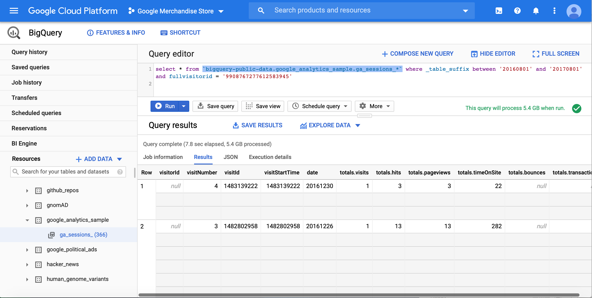
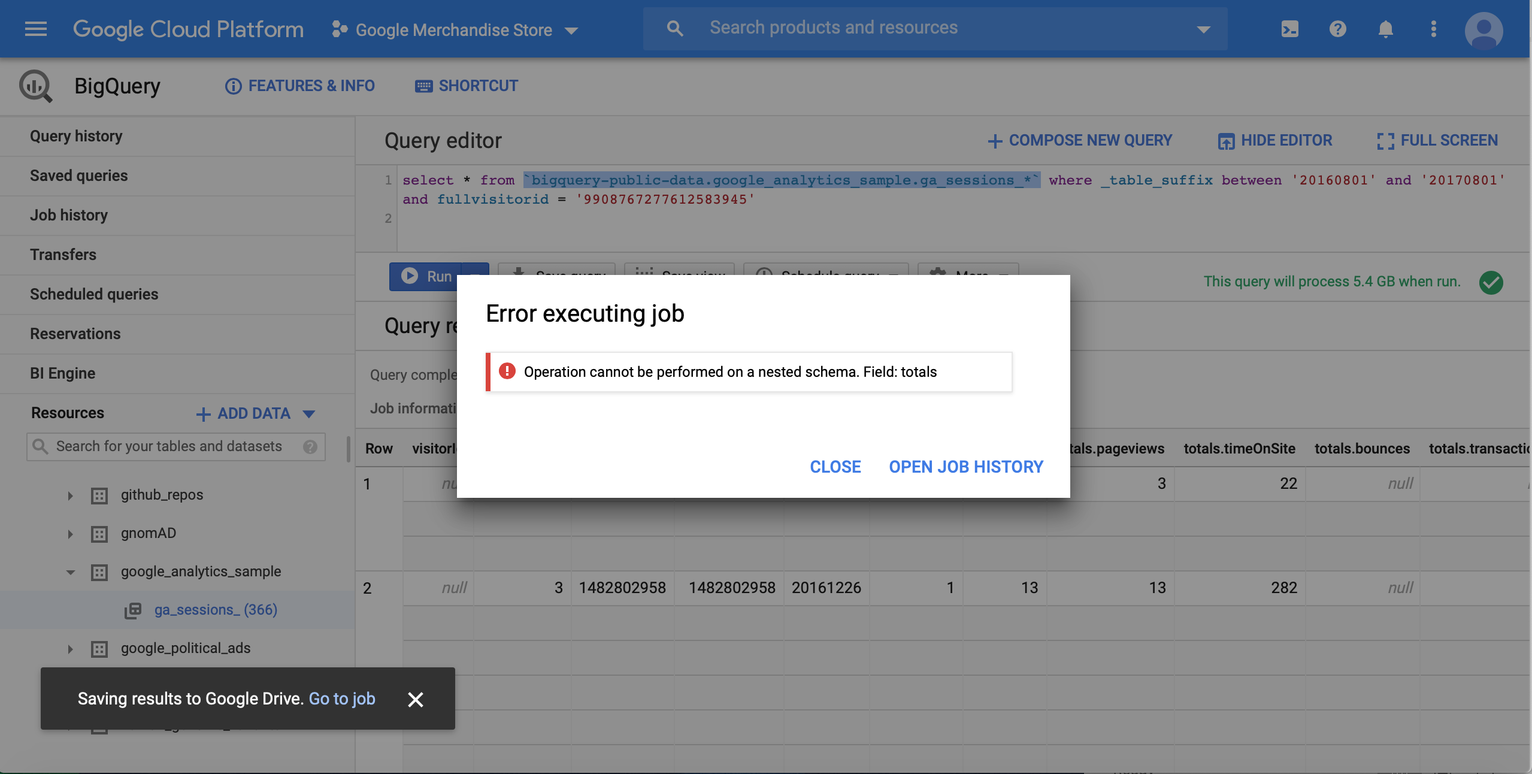
Google BigQuery Test
Sample Query:
select * from `bigquery-public-data.google_analytics_sample.ga_sessions_*` where _table_suffix between '20161201' and '20170101' and fullvisitorid = '9908767277612583945'
Wildcard documentation: https://cloud.google.com/bigquery/docs/querying-wildcard-tables#filtering_selected_tables_using_table_suffix

Slide 11
Nested Schema
StructType
ArrayType
Relational
ID | Name | Grade
 |  | Math | English
1 | Eric | 100 | 100
2 | Jane | 30 | 50
ID | Name | Skills
1 | Eric | Python, SQL, Tableau
2 | Jane | SQL, Tableau
ID | Name | Gender
1 | Eric | Male
2 | Jane | Female
[ { “ID”: 1,
“Name”: “Eric”,
“Grade”: {“Math”:100,
“English”: 100}
},
{ “ID”: 2,
“Name”: “Jane”,
“Grade”: { “Math”:30,
“English”: 50}
} ]
[ { “ID”: 1,
“Name”: “Eric”,
“Skills”: [ “Python”, “SQL”, “Tableau”]
},
{ “ID”: 2,
“Name”: “Jane”,
“Skills”: [ “SQL”, “Tableau”]
} ]

Slide 12
Nested Schema
ArrayType
ArrayType & StructType
ID | Name | Skills
1 | Eric | Python, SQL, Tableau
2 | Jane | SQL, Tableau
ID | Name | Skills (Name, Certified)
1 | Eric | (Python, Yes), (SQL,No), (Tableau, Yes)
2 | Jane | (SQL, Yes), (Tableau, No)
Un-nested
Un-nested
ID | Name | Skills
1 | Eric | Python
1 | Eric | SQL
1 | Eric | Tableau
2 | Jane | SQL
2 | Jane | Tableau
ID | Name | Skills
 |  | Name | Certified
1 | Eric | Python | Yes
1 | Eric | SQL | No
1 | Eric | Tableau | Yes
2 | Jane | SQL | Yes
2 | Jane | Tableau | No

Slide 13
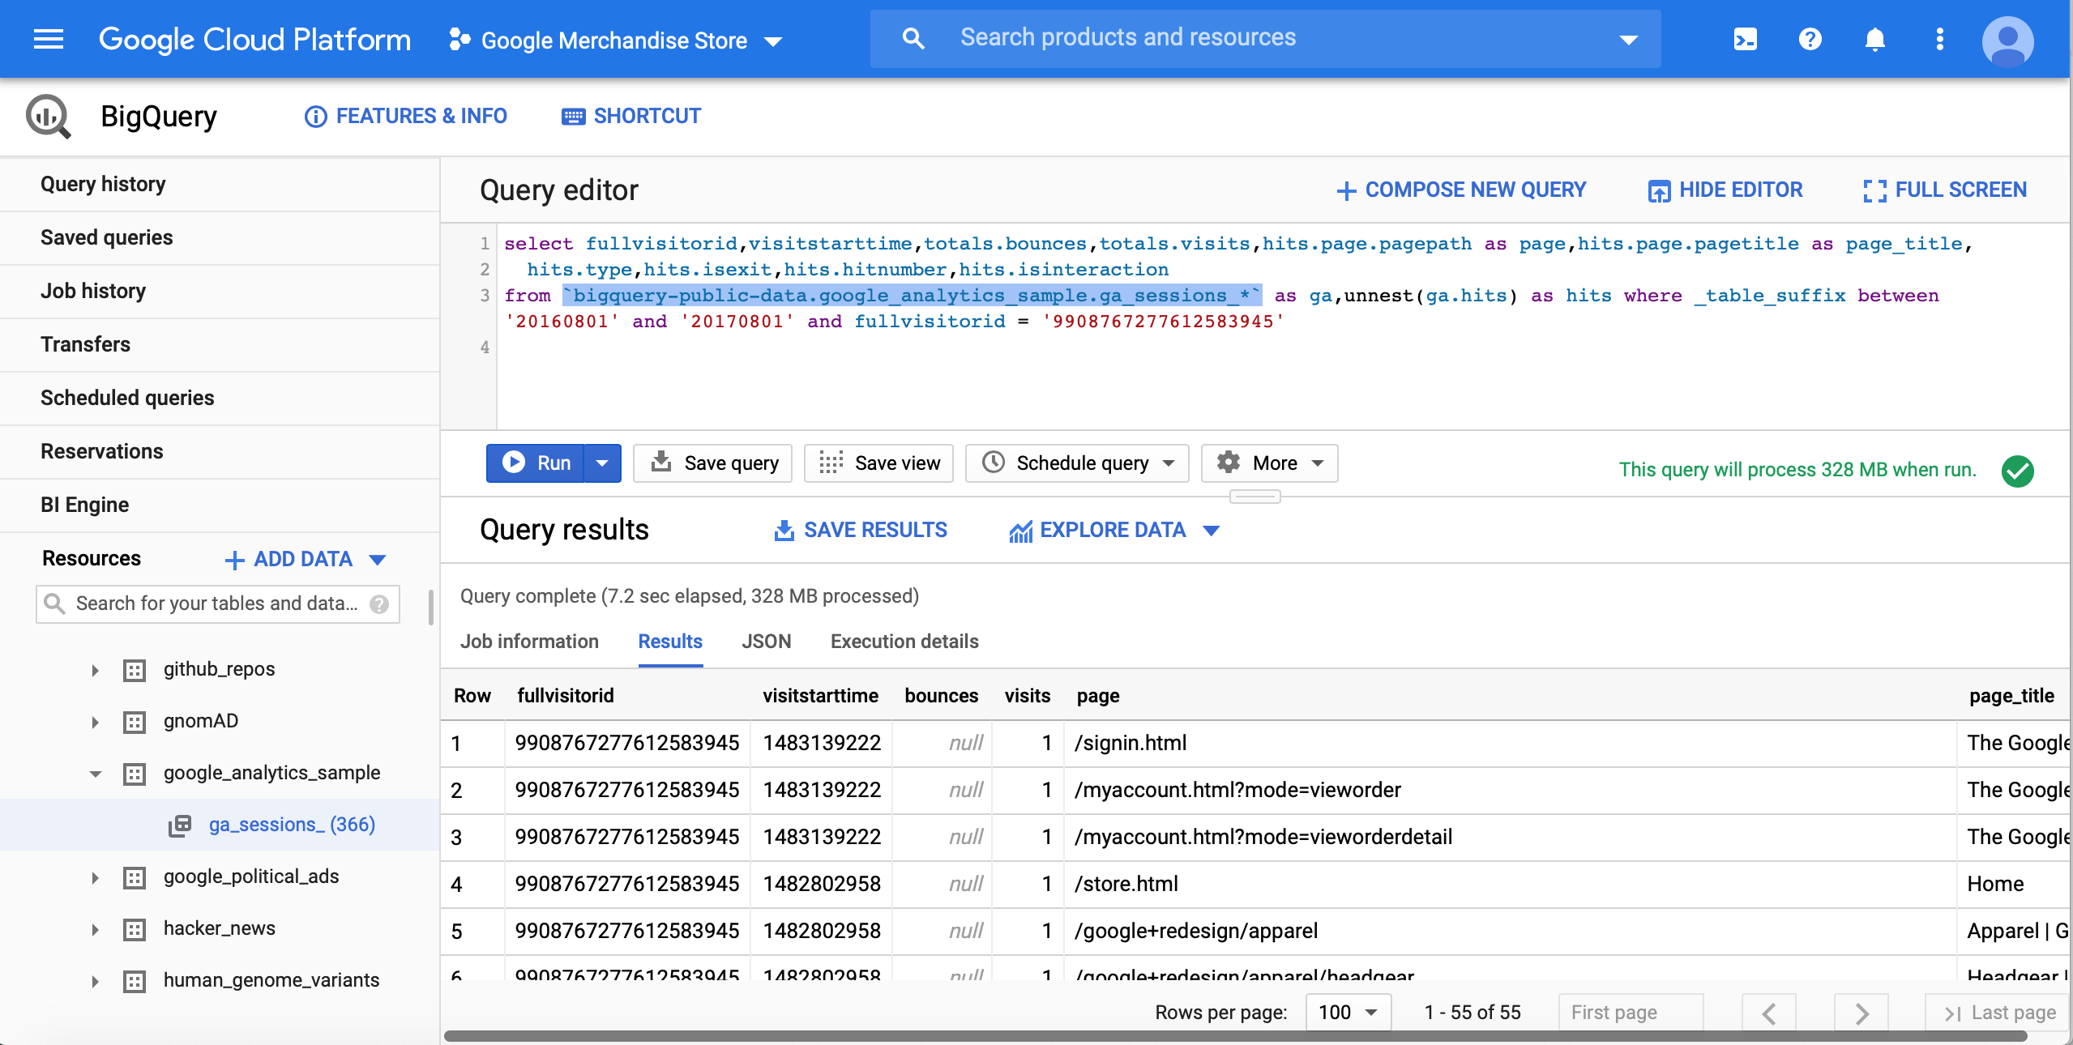
Google BigQuery Unest
Sample Query:
Select
fullvisitorid, visitstarttime, totals.bounces, totals.visits, hits.page.pagepath as page,
hits.page.pagetitle as page_title, hits.type, hits.isexit, hits.hitnumber, hits.isinteraction
from `bigquery-public-data.google_analytics_sample.ga_sessions_*` as ga,unnest(ga.hits) as hits
where _table_suffix between '20161201' and '20170101' and fullvisitorid = '9908767277612583945'
Unnest documentation: https://medium.com/firebase-developers/using-the-unnest-function-in-bigquery-to-analyze-event-parameters-in-analytics-fb828f890b42

Slide 14
Google Analytics Lab
2. KPIs

Slide 15
KPIs – Page Related
Total Sessions Total number of session (close browser/no activity after 30 mins/pass midnight)
Total Pageviews Total number of page viewed
Total Unique Pageviews Total number of unique page viewed
Total Bounces Total number of bounces (exactly one interaction event)
Avg Duration How much time the user would spend for each session on avg
Avg Time on Page How much time the user would spend for each page on avg
Avg Pageviews How many page would a user view for each session on avg
Avg Unique Pageviews How many unique page would a user view for each session on avg
Daily Sessions How many sessions per day
Bounce % Total bounces / Total sessions
Exit % Total exits / Total pageviews

Slide 16
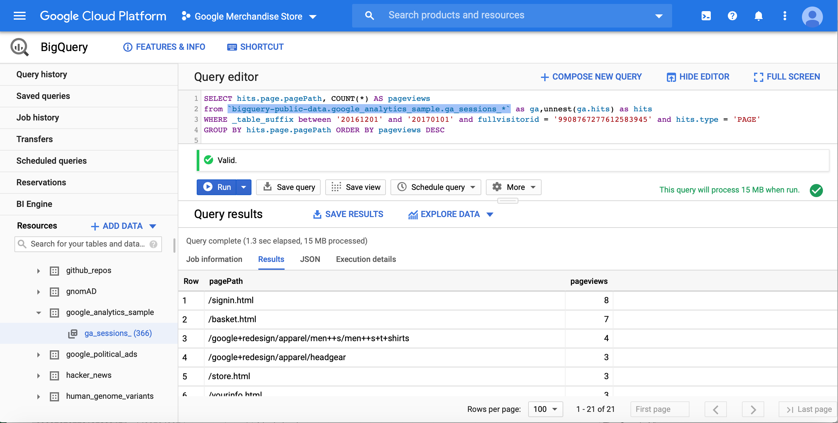
Total Pageviews
Sample Query:
SELECT hits.page.pagePath, COUNT(*) AS pageviews
FROM `bigquery-public-data.google_analytics_sample.ga_sessions_*` as ga,unnest(ga.hits) as hits
WHERE _table_suffix between '20161201' and '20170101' and fullvisitorid = '9908767277612583945' and hits.type = 'PAGE'
GROUP BY hits.page.pagePath ORDER BY pageviews DESC

Slide 17
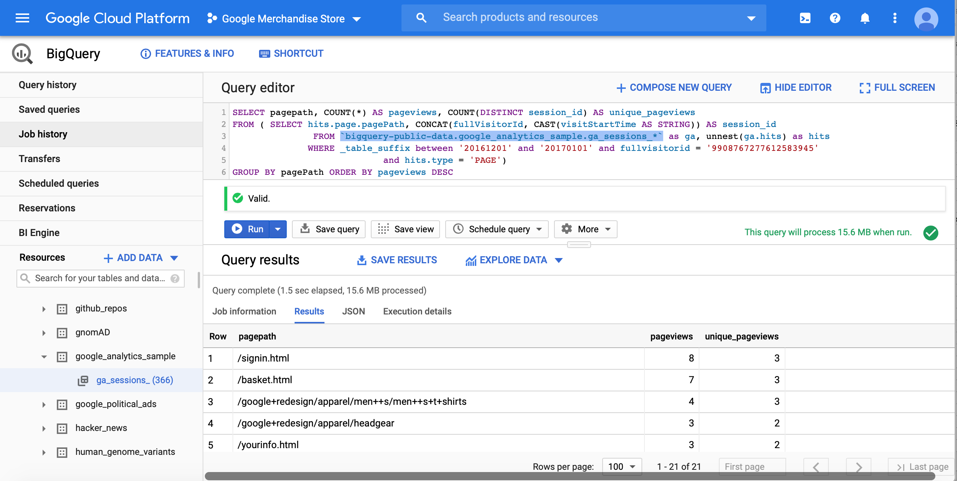
Total Unique Pageviews
Sample Query:
SELECT pagepath, COUNT(*) AS pageviews, COUNT(DISTINCT session_id) AS unique_pageviews
FROM ( SELECT hits.page.pagePath, CONCAT(fullVisitorId, CAST(visitStartTime AS STRING)) AS session_id
FROM `bigquery-public-data.google_analytics_sample.ga_sessions_*` as ga, unnest(ga.hits) as hits
WHERE _table_suffix between '20161201' and '20170101' and fullvisitorid = '9908767277612583945'
and hits.type = 'PAGE')
GROUP BY pagePath ORDER BY pageviews DESC
Note:
If a page is viewed multiple times during one session, it should be count as 1
Do NOT use visitId as indicator for different session, session breaks at midnight

Slide 18
Average Time on Page
Calculation formula:
Average time on page = Total time on page / (Total Pageviews – Total Exits)
This one is very tricky, let’s calculate the each section and assemble them together.

Slide 19
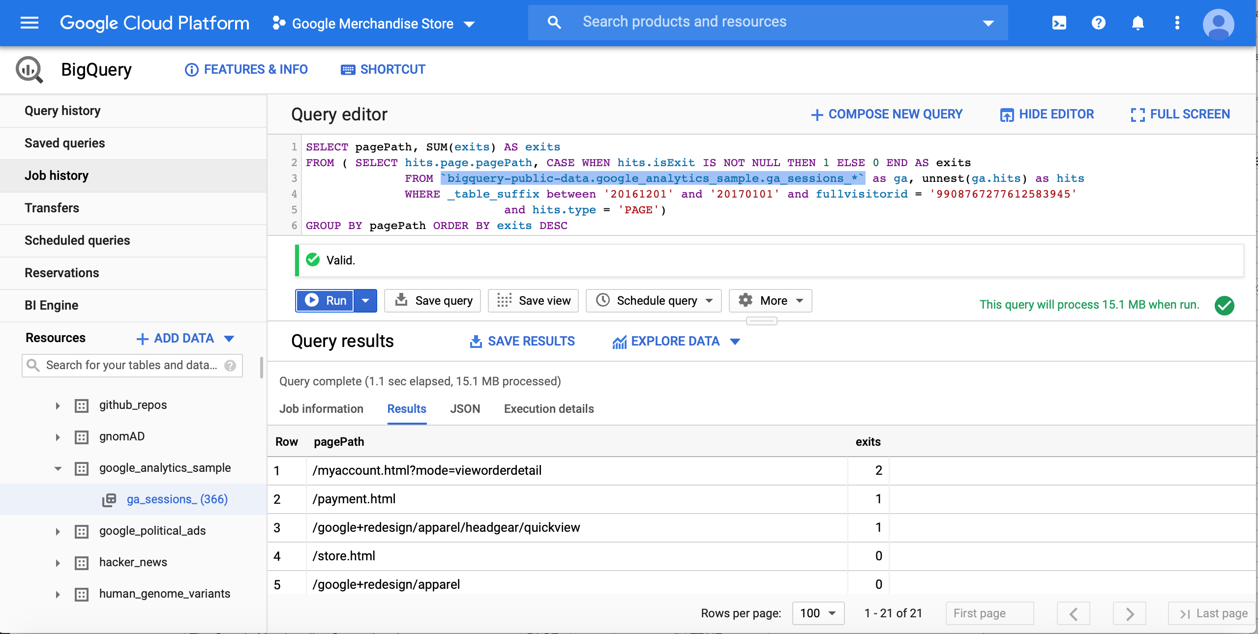
Average Time on Page
Sample Query for Total Exits:
SELECT pagePath, SUM(exits) AS exits
FROM ( SELECT hits.page.pagePath, CASE WHEN hits.isExit IS NOT NULL THEN 1 ELSE 0 END AS exits
FROM `bigquery-public-data.google_analytics_sample.ga_sessions_*` as ga, unnest(ga.hits) as hits
WHERE _table_suffix between '20161201' and '20170101' and fullvisitorid = '9908767277612583945'
and hits.type = 'PAGE')
GROUP BY pagePath ORDER BY exits DESC
Note:
Exit is indicated by hits.isExit and the result is True or Null

Slide 20
Average Time on Page
Sample Query for Total Time on Page (not exit):
SELECT fullVisitorId, visitStartTime, pagePath, hit_time, LEAD(hit_time) OVER (PARTITION BY fullVisitorId, visitStartTime ORDER BY hit_time) AS next_pageview
FROM ( SELECT fullVisitorId, visitStartTime, hits.page.pagePath, hits.time / 1000 AS hit_time
FROM `bigquery-public-data.google_analytics_sample.ga_sessions_*` as ga, unnest(ga.hits) as hits
WHERE _table_suffix between '20161201' and '20170101' and fullvisitorid = '9908767277612583945'
and hits.type = 'PAGE')
Note:
If the page is not an exit, time on page is the next pageview time – current pageview time
Sample Query for Total Time on Page (exit):
SELECT fullVisitorId, visitStartTime, hits.page.pagePath, MAX(IF(hits.isInteraction IS NOT NULL, hits.time, 0))
OVER (PARTITION BY fullVisitorId, visitStartTime) as last_interaction
FROM `bigquery-public-data.google_analytics_sample.ga_sessions_*` AS GA, UNNEST(GA.hits) AS hits
WHERE _table_suffix between '20161201' and '20170101' and fullvisitorid = '9908767277612583945'
Note:
If the page is an exit, time on page is the last interaction time – current pageview time

Slide 21
Average Time on Page
Sample Query for Total Time on Page (exit & non-exit combined):
SELECT fullVisitorId, visitStartTime, pagePath, hit_time, type, isExit,
CASE WHEN isExit IS NOT NULL THEN last_interaction - hit_time
ELSE next_pageview - hit_time END AS time_on_page
FROM ( SELECT fullVisitorId, visitStartTime, pagePath, hit_time, type, isExit, last_interaction,
LEAD(hit_time) OVER (PARTITION BY fullVisitorId, visitStartTime ORDER BY hit_time) AS next_pageview
FROM ( SELECT fullVisitorId, visitStartTime, pagePath, hit_time, type, isExit, last_interaction
FROM ( SELECT fullVisitorId, visitStartTime, hits.page.pagePath, hits.type, hits.isExit,
hits.time / 1000 AS hit_time, MAX(IF(hits.isInteraction IS NOT NULL, hits.time / 1000, 0))
OVER (PARTITION BY fullVisitorId, visitStartTime) AS last_interaction
FROM `bigquery-public-data.google_analytics_sample.ga_sessions_*`AS GA,
UNNEST(GA.hits) AS hits
WHERE _table_suffix between '20161201' and '20170101' and fullvisitorid = '9908767277612583945')
WHERE type = 'PAGE')
)
Note:
Blue Section – calculate basic values like hit time, last interaction time
Green Section – filter out hit only relevant to ‘Page’
Purple Section – calculate the next page view hit time
Black Section – calculate time on page for different scenarios
Be careful with the position of WHERE type = ‘Page’ - Why????

Slide 22
Average Time on Page
Sample Query for Average Time on Page (final):
SELECT pagePath, pageviews, exits, total_time_on_page, CASE WHEN pageviews = exits THEN 0
ELSE total_time_on_page / (pageviews - exits) END AS avg_time_on_page
FROM ( SELECT pagePath, COUNT(*) AS pageviews, SUM(IF(isExit IS NOT NULL, 1, 0)) AS exits,
SUM(time_on_page) AS total_time_on_page
FROM ( SELECT fullVisitorId, visitStartTime, pagePath, hit_time, type, isExit, CASE WHEN isExit IS NOT NULL
THEN last_interaction - hit_time ELSE next_pageview - hit_time END AS time_on_page
FROM ( SELECT fullVisitorId, visitStartTime, pagePath, hit_time, type, isExit, last_interaction, LEAD(hit_time)
OVER (PARTITION BY fullVisitorId, visitStartTime ORDER BY hit_time) AS next_pageview
FROM ( SELECT fullVisitorId, visitStartTime, pagePath, hit_time, type, isExit, last_interaction
FROM ( SELECT fullVisitorId, visitStartTime, hits.page.pagePath, hits.type, hits.isExit,
hits.time / 1000 AS hit_time, MAX(IF(hits.isInteraction IS NOT NULL, hits.time /
1000, 0)) OVER (PARTITION BY fullVisitorId, visitStartTime) AS last_interaction
FROM `bigquery-public-data.google_analytics_sample.ga_sessions_*` AS GA,
UNNEST(GA.hits) AS hits
WHERE _table_suffix between '20161201' and '20170101'
and fullvisitorid = '9908767277612583945')
WHERE type = 'PAGE')
)
)
GROUP BY pagePath)
ORDER BY pageviews DESC
Note:
Blue Section – Query from Total Time on Page
Green Section – Query from Total Pageviews and Total Exits
Purple Section – Calculate Average Time on Page

Slide 23
Bounce Rate
Calculation formula:
Bounce Rate = Total Bounces / Total Sessions
This one is very tricky as well, let’s calculate the each section and assemble them together.

Slide 24
Bounce Rate
Sample Query for Total Bounces:
SELECT fullVisitorId, visitStartTime, pagePath,
CASE WHEN hitNumber = first_interaction THEN bounces ELSE 0 END AS bounces
FROM ( SELECT fullVisitorId, visitStartTime, hits.page.pagePath, totals.bounces, hits.hitNumber,
MIN(IF(hits.isInteraction IS NOT NULL, hits.hitNumber, 0)) OVER (PARTITION BY fullVisitorId, visitStartTime) AS first_interaction
FROM `bigquery-public-data.google_analytics_sample.ga_sessions_*` as ga, unnest(ga.hits) as hits
WHERE _table_suffix between '20161201' and '20170101' and fullvisitorid = '9908767277612583945' )
Note:
Bounce is associated with the first interaction hit. If there is exactly one interaction event, total.bounces would be 1
Sample Query for Total Sessions:
SELECT fullVisitorId, visitStartTime, pagePath,
CASE WHEN hitNumber = first_hit THEN visits ELSE 0 END AS sessions
FROM ( SELECT fullVisitorId, visitStartTime, hits.page.pagePath, totals.visits, hits.hitNumber,
MIN(hits.hitNumber) OVER (PARTITION BY fullVisitorId, visitStartTime) AS first_hit
FROM `bigquery-public-data.google_analytics_sample.ga_sessions_*` as ga, unnest(ga.hits) as hits
WHERE _table_suffix between '20161201' and '20170101' and fullvisitorid = '9908767277612583945' )
Note:
Session is associated with the first hit, and there should be at least one interaction event.

Slide 25
Bounce Rate
Sample Query for Bounces Rate:
select pagePath, bounces, sessions, CASE WHEN sessions = 0 THEN 0 ELSE bounces / sessions END AS bounce_rate
FROM ( SELECT pagePath, SUM(bounces) AS bounces, SUM(sessions) AS sessions
FROM ( SELECT fullVisitorId, visitStartTime, pagePath,
CASE WHEN hitNumber = first_interaction THEN bounces ELSE 0 END AS bounces,
CASE WHEN hitNumber = first_hit THEN visits ELSE 0 END AS sessions
FROM ( SELECT fullVisitorId, visitStartTime, hits.page.pagePath, totals.bounces, totals.visits, hits.hitNumber,
MIN(IF(hits.isInteraction IS NOT NULL, hits.hitNumber, 0))
OVER (PARTITION BY fullVisitorId, visitStartTime) AS first_interaction,
MIN(hits.hitNumber) OVER (PARTITION BY fullVisitorId, visitStartTime) AS first_hit
FROM `bigquery-public-data.google_analytics_sample.ga_sessions_*` as ga, unnest(ga.hits) as hits
WHERE _table_suffix between '20161201' and '20170101' and fullvisitorid = '9908767277612583945' )
)
GROUP BY pagePath)
ORDER BY sessions DESC
Note:
Blue Section – calculate basic values like hit number of first interaction/ first hit
Green Section – calculate if a page is bounce or session
Purple Section – aggregate results by page
Black Section – calculate bounce rate

Slide 26
Google Analytics Lab
3. Google BigQuery

Slide 27
Final Query
Let’s combine everything we have learnt so far and condense it into one single query:
BigQuery-Google Merchandise Store.txt

Slide 28
Google Analytics Lab
4. Data Visualization

Slide 29


BI Tools Comparison
Gartner 2020

Slide 30

Google Analytics Dashboard
https://linpack-for-tableau.com/data-visualizations/tableau-dashboards/google-analytics-dashboard/custom-home/

Slide 31
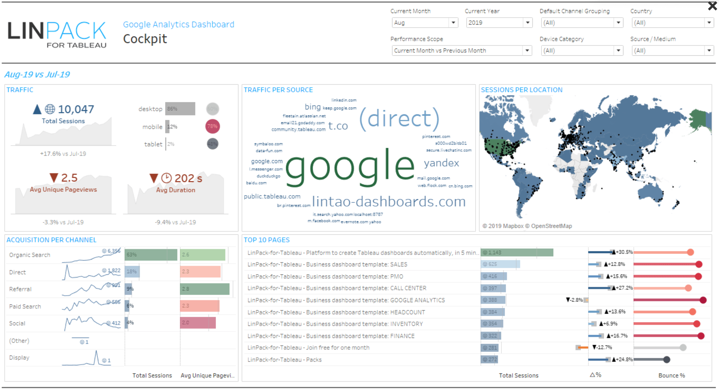
Google Analytics Dashboard

Slide 32
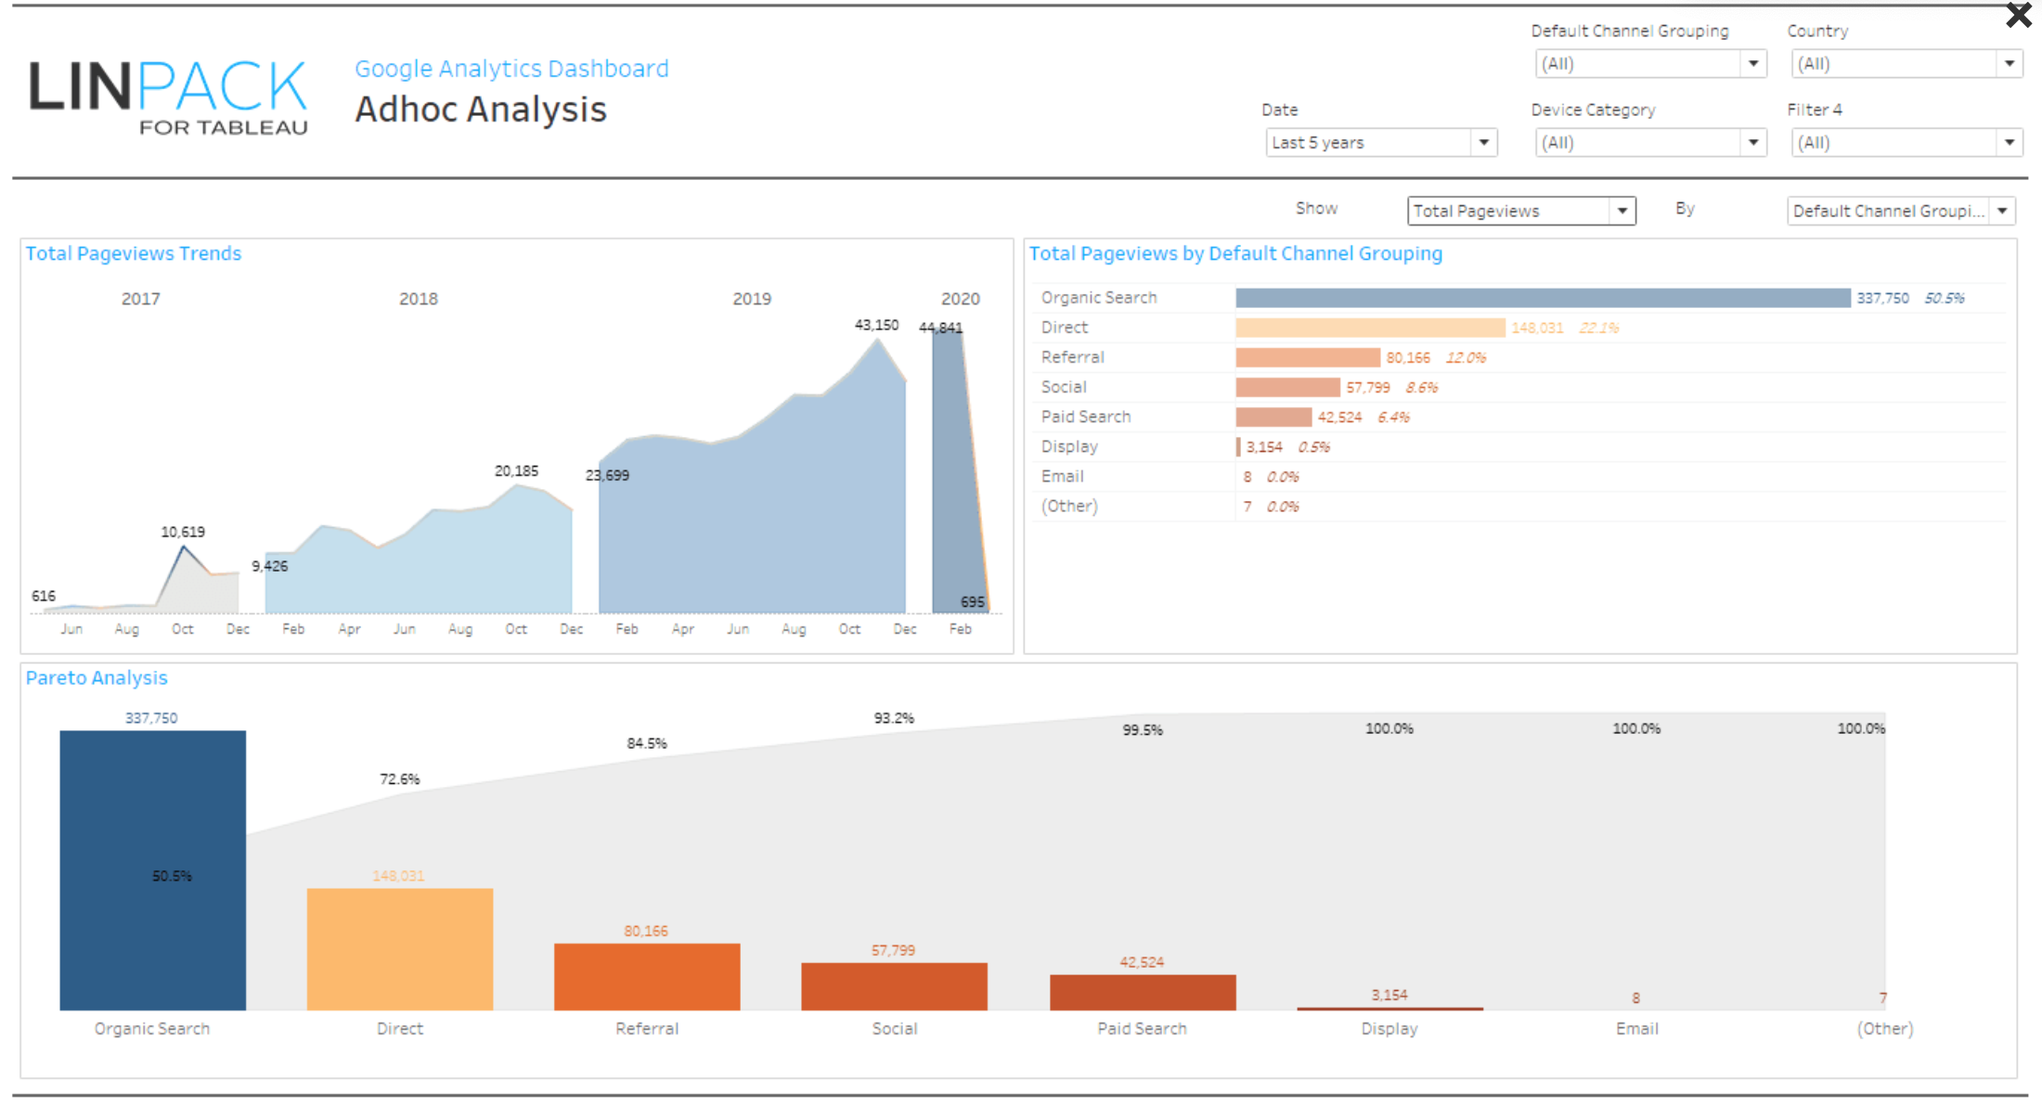
Google Analytics Dashboard

Slide 33
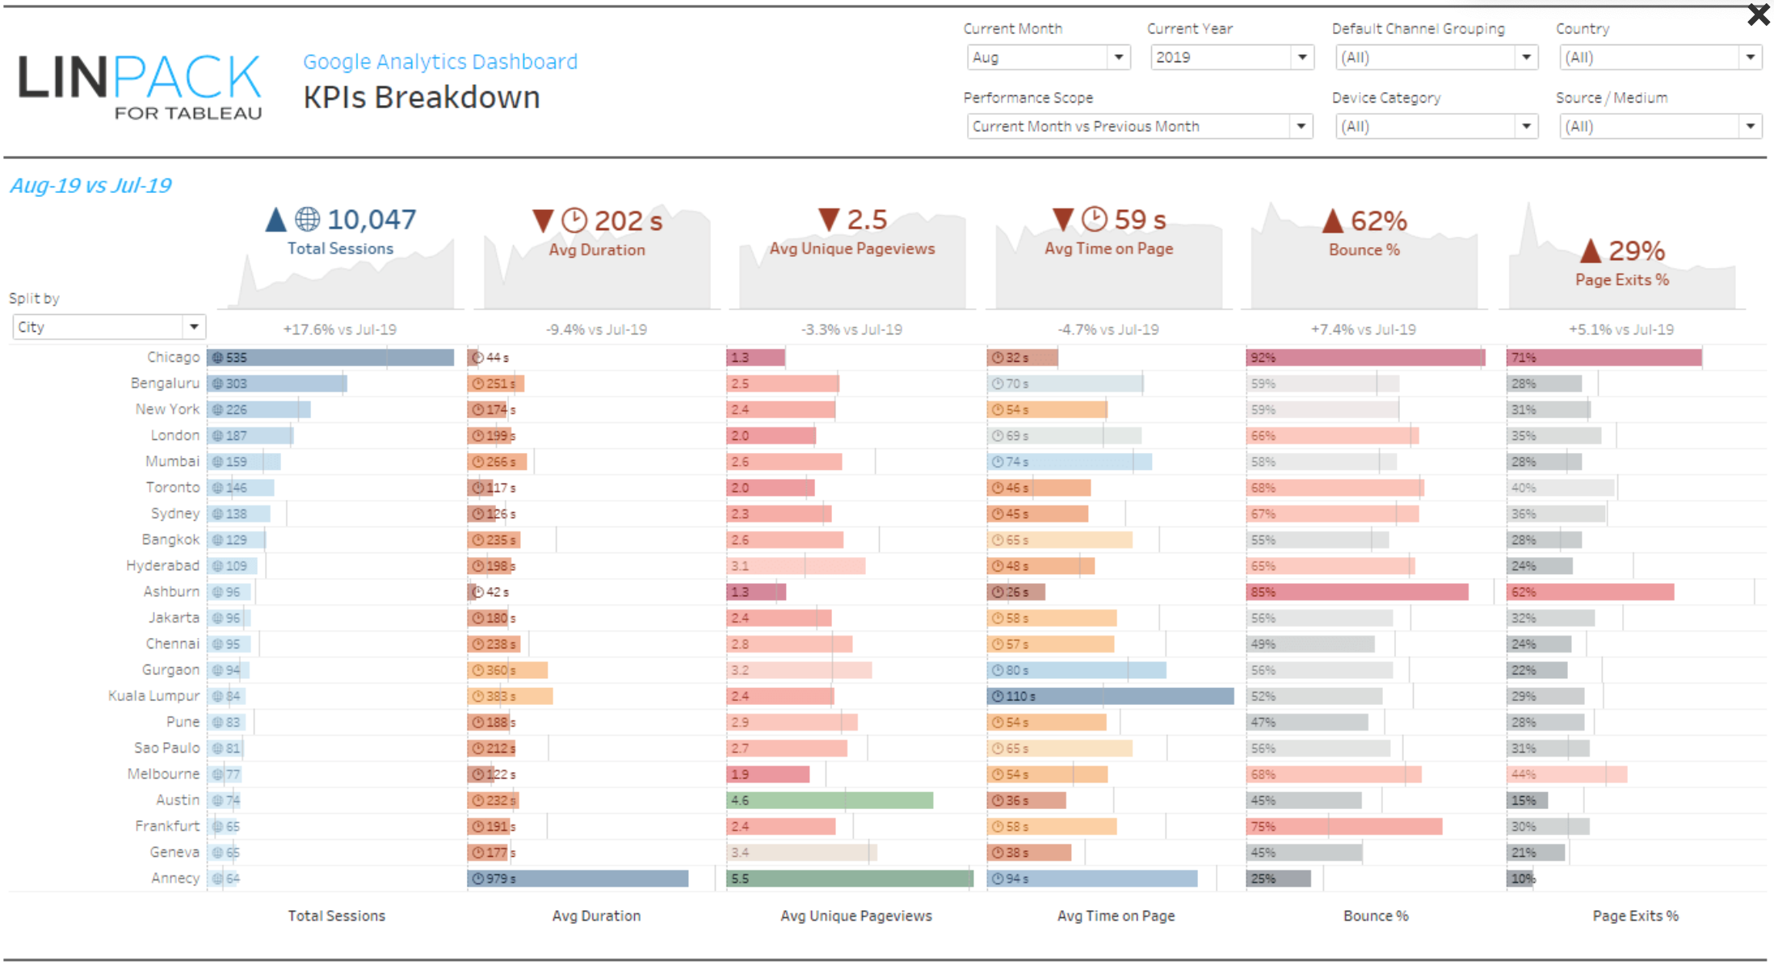
Google Analytics Dashboard

Slide 34
Congratulations!
You did it!

